Slide 1
Welcome to Art Class, AES!
Sara Ramos, Art Educator

Slide 2
Welcome to Art class at AEs
My name is Sara Ramos and I have been teaching Art at Amesbury Elementary School for 8 years.
My journey as both an artist and educator has been both challenging and joyful. My promise to you is that this year will be just as joyful as before.
It might be a little challenging sometimes but we will work together.

Slide 4
A Variety of Art Projects
I believe that all children are innately creative and that our job as teachers is to encourage and nurture our students.
I have created a curriculum at AES that offers our students opportunities to explore and experience a variety of materials and techniques.
Every child is their own unique artist and my goal is to make sure all of my students can be successful and grow creatively in their own ways.

Slide 7
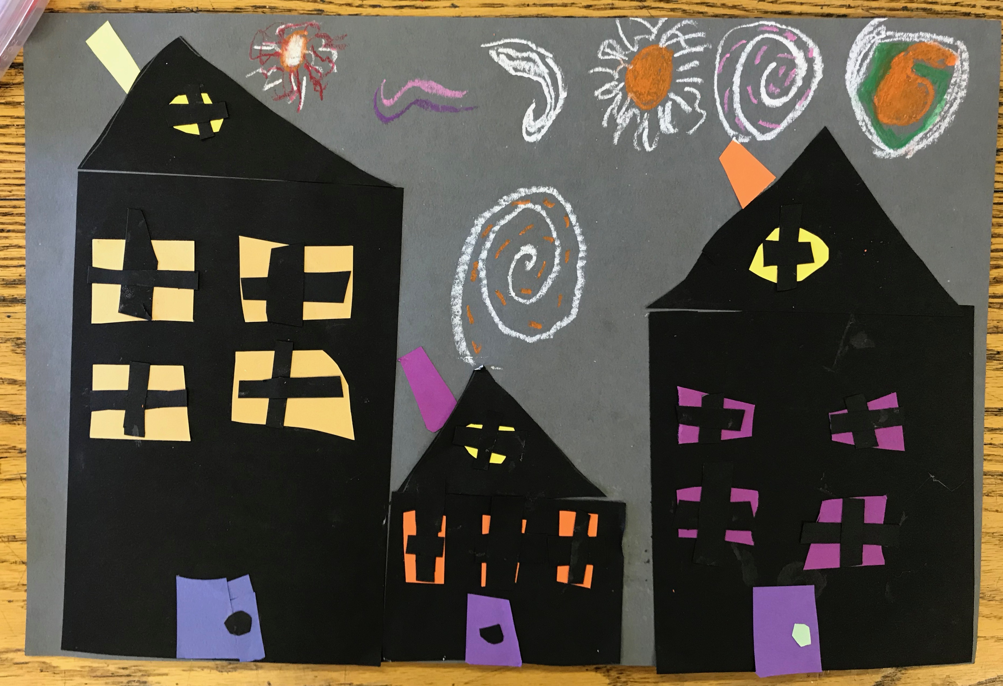

Slide 8
I look forward to working with all of my students! I am excited about all of the fun things that we learn together.

